Slide 1

Train Maniac
---A Multi purpose Train Tracking WEB APP---
Presented By- Team : SHA:{508}
---A Team Of 3 Who Thought Differently And Met Randomly..

Slide 2
ABOUT :
A Train tracking web application which caters to your demands regarding trains.
An application which has information about your PNR status.
Interactive application which tells all the available trains between 2 stations on any date.
Seat availability of any train is just given on user demands.
Served with a live tracking Google Map which tells the exact position of your train.

Slide 3

Let’s Have An Awesome Look….

Slide 4
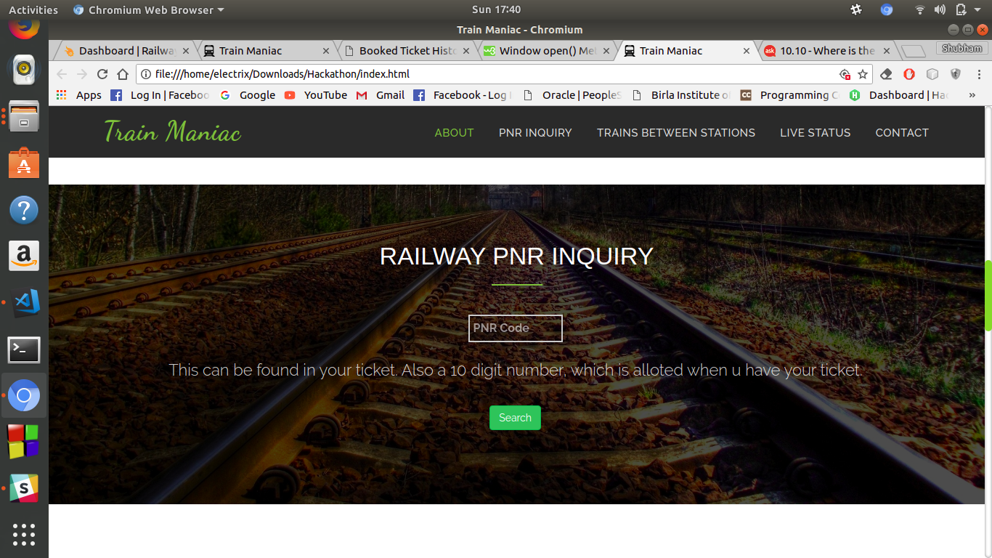
Check Your PNR :

Slide 5
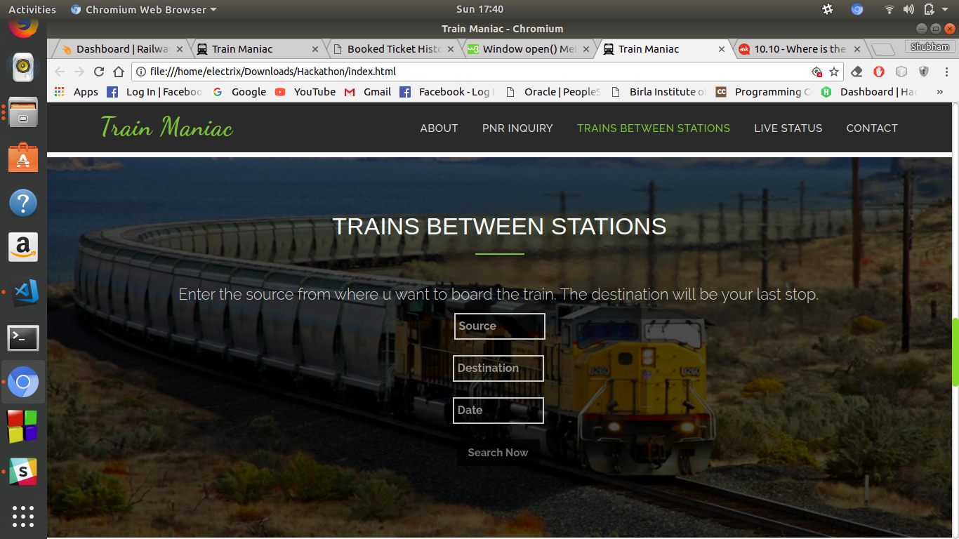
Availability Between Stations :

Slide 6
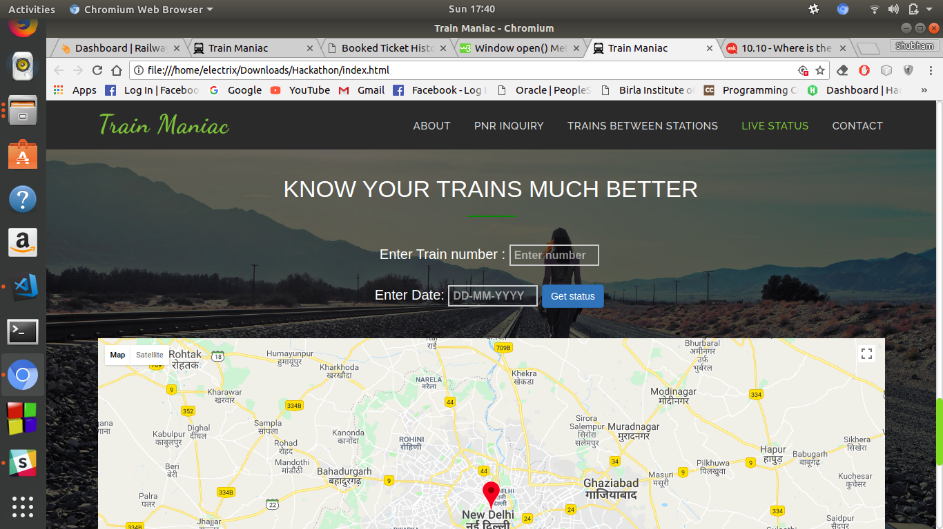
LIVE Tracking Facility:

Slide 7
Tech Involved :
Live Train Status: https://api.railwayapi.com/v2/live/train/<train number>/date/<dd-mm-yyyy>/apikey/<apikey>/ {
Json : "response_code": 200, "debit": 3, "position": "Train has reached Destination and late by 5 minutes", "train": { "number": "12046", "name": "CDG NDLS SHTBDI" }, "route": [ { "no": 1, "day": 0, "station": { "name": "CHANDIGARH", "code": "CDG" }, "has_arrived": false, "has_departed": true, "distance": 0, "scharr": "Source", "schdep": "12:00", "actarr": "00:00", "actdep": "12:00", "scharr_date": "19 Nov 2015", "actarr_date": "19 Nov 2015", "latemin": 0
For PNR:https://api.railwayapi.com/v2/pnr-status/pnr/<pnr no>/apikey/<apikey>/
For Seats Availibility api :https://api.railwayapi.com/v2/between/source/<stn code>/dest/<stn code>/date/<dd-mm-yyyy>/apikey/<apikey>/
HTML5, CSS3, Bootstap4, Es6 for frontend.

Slide 8
TEAM Involved !!
Ayushi
Shubham
Harshit

